Slide 1

職場故事 (Animaze)
Notes:
Video by <a href="https://pixabay.com/users/u_9cdufm6xxs-31781072/?utm_source=link-attribution&utm_medium=referral&utm_campaign=video&utm_content=141481">u_9cdufm6xxs</a> from <a href="https://pixabay.com//?utm_source=link-attribution&utm_medium=referral&utm_campaign=video&utm_content=141481">Pixabay</a>

Slide 2
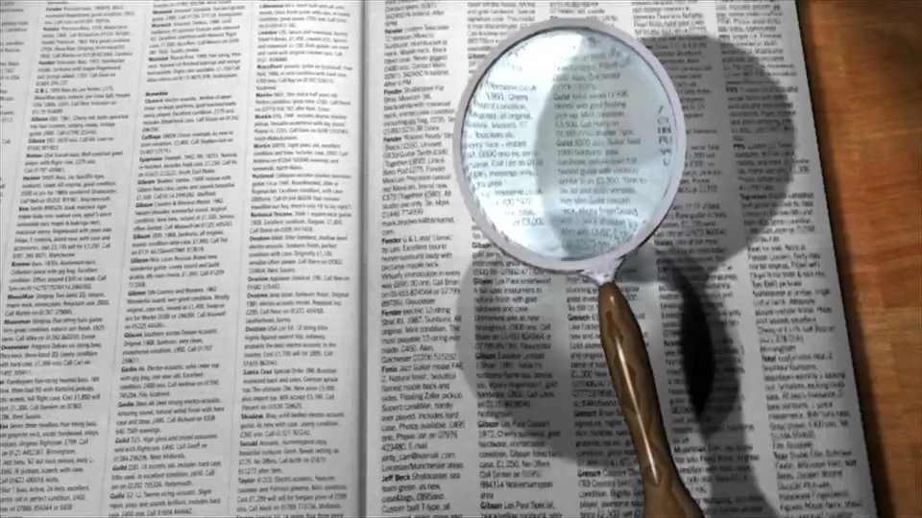
一、目標
Notes:
Video by <a href="https://pixabay.com/users/tommyvideo-3092371/?utm_source=link-attribution&utm_medium=referral&utm_campaign=video&utm_content=5393">Tomislav Jakupec</a> from <a href="https://pixabay.com//?utm_source=link-attribution&utm_medium=referral&utm_campaign=video&utm_content=5393">Pixabay</a>

Slide 3
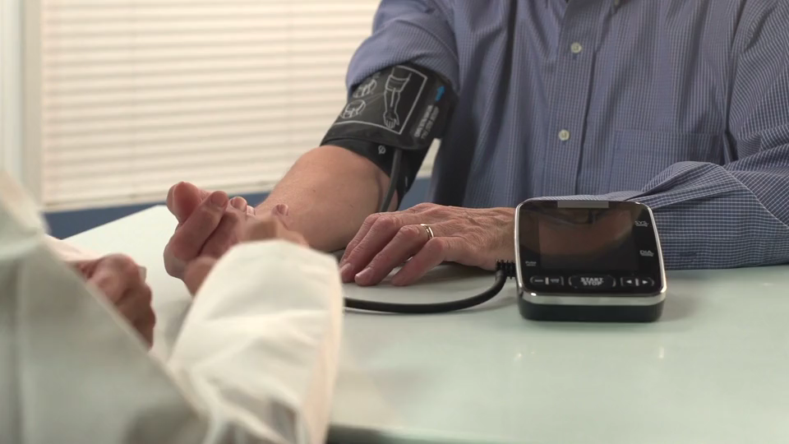
二、阻礙
Notes:
Video by <a href="https://pixabay.com/users/hassas_arts-12571684/?utm_source=link-attribution&utm_medium=referral&utm_campaign=video&utm_content=49815">Hassas Arts</a> from <a href="https://pixabay.com//?utm_source=link-attribution&utm_medium=referral&utm_campaign=video&utm_content=49815">Pixabay</a>

Slide 4

三、努力
Notes:
Video by <a href="https://pixabay.com/users/matthias_groeneveld-4535957/?utm_source=link-attribution&utm_medium=referral&utm_campaign=video&utm_content=120679">Matthias Groeneveld</a> from <a href="https://pixabay.com//?utm_source=link-attribution&utm_medium=referral&utm_campaign=video&utm_content=120679">Pixabay</a>

Slide 5
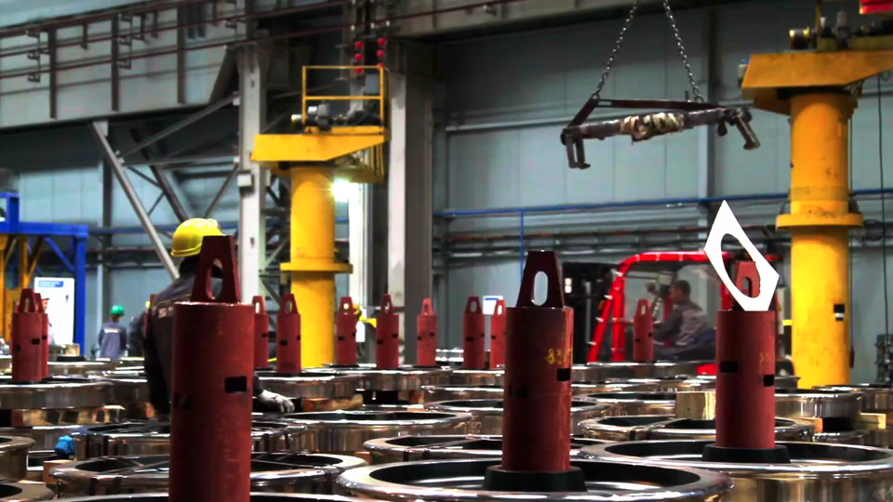
Notes:
Video by <a href="https://pixabay.com/users/alexkopeykin-6178059/?utm_source=link-attribution&utm_medium=referral&utm_campaign=video&utm_content=40054">Олександр Копєйкін</a> from <a href="https://pixabay.com//?utm_source=link-attribution&utm_medium=referral&utm_campaign=video&utm_content=40054">Pixabay</a>

Slide 6

四、結果
Notes:
Video by <a href="https://pixabay.com/users/conte_public-41658361/?utm_source=link-attribution&utm_medium=referral&utm_campaign=video&utm_content=204420">MeD</a> from <a href="https://pixabay.com//?utm_source=link-attribution&utm_medium=referral&utm_campaign=video&utm_content=204420">Pixabay</a>

Slide 7

五、意外
Notes:
Video by <a href="https://pixabay.com/users/amuns99-15787145/?utm_source=link-attribution&utm_medium=referral&utm_campaign=video&utm_content=34473">Albert Muns</a> from <a href="https://pixabay.com//?utm_source=link-attribution&utm_medium=referral&utm_campaign=video&utm_content=34473">Pixabay</a>

Slide 8

六、轉彎
Notes:
Video by <a href="https://pixabay.com/users/samidurrakzai-42221807/?utm_source=link-attribution&utm_medium=referral&utm_campaign=video&utm_content=202135">Sami Ullah</a> from <a href="https://pixabay.com//?utm_source=link-attribution&utm_medium=referral&utm_campaign=video&utm_content=202135">Pixabay</a>

Slide 9

Notes:
Video by <a href="https://pixabay.com/users/huchideng0769-17752754/?utm_source=link-attribution&utm_medium=referral&utm_campaign=video&utm_content=46284">chideng hu</a> from <a href="https://pixabay.com//?utm_source=link-attribution&utm_medium=referral&utm_campaign=video&utm_content=46284">Pixabay</a>

Slide 10

七、結局
Notes:
Video by <a href="https://pixabay.com/users/joe_hackney-15024843/?utm_source=link-attribution&utm_medium=referral&utm_campaign=video&utm_content=171085">Joe Hackney</a> from <a href="https://pixabay.com//?utm_source=link-attribution&utm_medium=referral&utm_campaign=video&utm_content=171085">Pixabay</a>

